Slide 1
CREDIT CARD FRAUD DETECTION
Submitted in the partial fulfillment for the award of the degree of
BACHELOR OF ENGINEERING
IN
COMPUTER SCIENCE AND ENGINEERING BDA
Submitted by:
Ankush Singh Bisht 21BCS6681
Kunal Wadhwa 21BCS6631
Under the Supervision of:
Prabjot Singh Bali
Department of AIT-CSE
DISCOVER . LEARN . EMPOWER

Slide 2
Outline
Introduction to Project
Problem Formulation
Objectives of the work
Methodology used
Results and Outputs
Conclusion
Future Scope
References

Slide 3

Introduction to Project
Credit card fraud means using a persons credit card card without his knowledge by means of withdrawing funds or purchase of goods. The most common ways of card theft are done by stealing the card before it is received by the owner , getting the card details from the owner via phone calls sending inappropriate links to the owners mobile to get the card details details, appropriation of lost cards and so on.

Slide 4
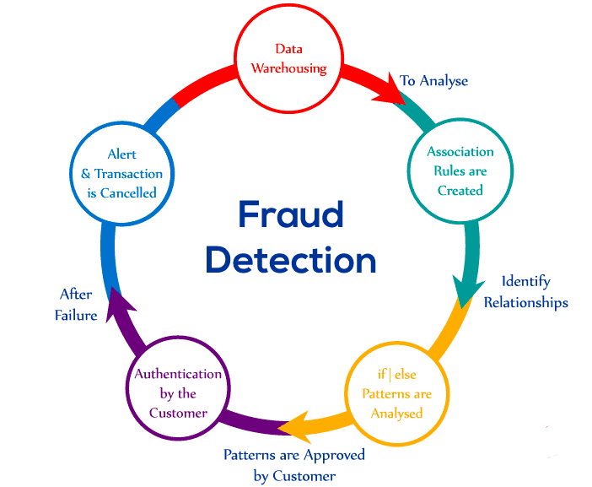
Problem Formulation
The Credit Card Fraud Detection Problem includes modeling past credit card transactions with the knowledge of the ones that turned out to be fraud. This model is then used to identify whether a new transaction is fraudulent or not.

Slide 5

Objectives of the Work
Credit card fraud detection is the collective term for the policies, tools, methodologies, and practices that credit card companies and financial institutions take to combat identity fraud and stop fraudulent transactions

Slide 6
Methodology used
Never give your card to others.
Never share your banking details in any online portals and social media.
Do not write the credit card number or pin number in any places.
Do not disclose card information and OTP over the phone calls
Do not leave the card or receipts unattended.
Communicate with the card company immediately regarding issues like loss of card or change of address or any doubtful cards.

Slide 7
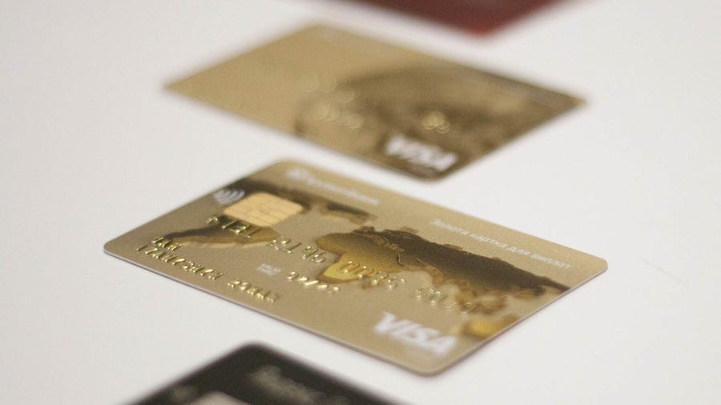

The proposed techniques are used in this paper, for detecting the frauds in credit card system. The comparison are made for different machine learning algorithms such as Logistic Regression, Decision Trees, Random Forest, Naive Bayes to determine which algorithm gives suits best and can be adapted by credit card merchants for identifying fraud transactions. The Figure1 shows the architectural diagram for representing the overall system framework.

Slide 8
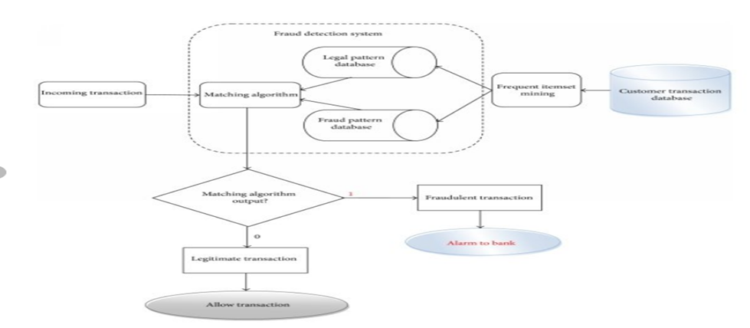

Slide 9
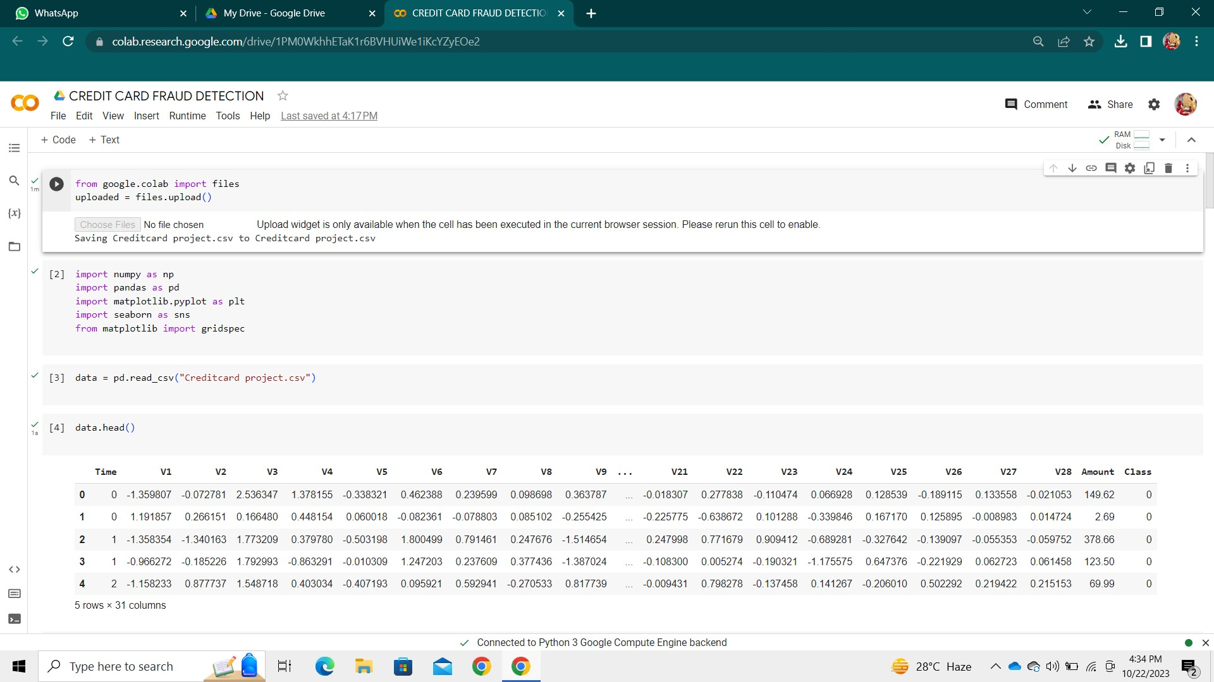
Results and Outputs

Slide 10


Slide 11
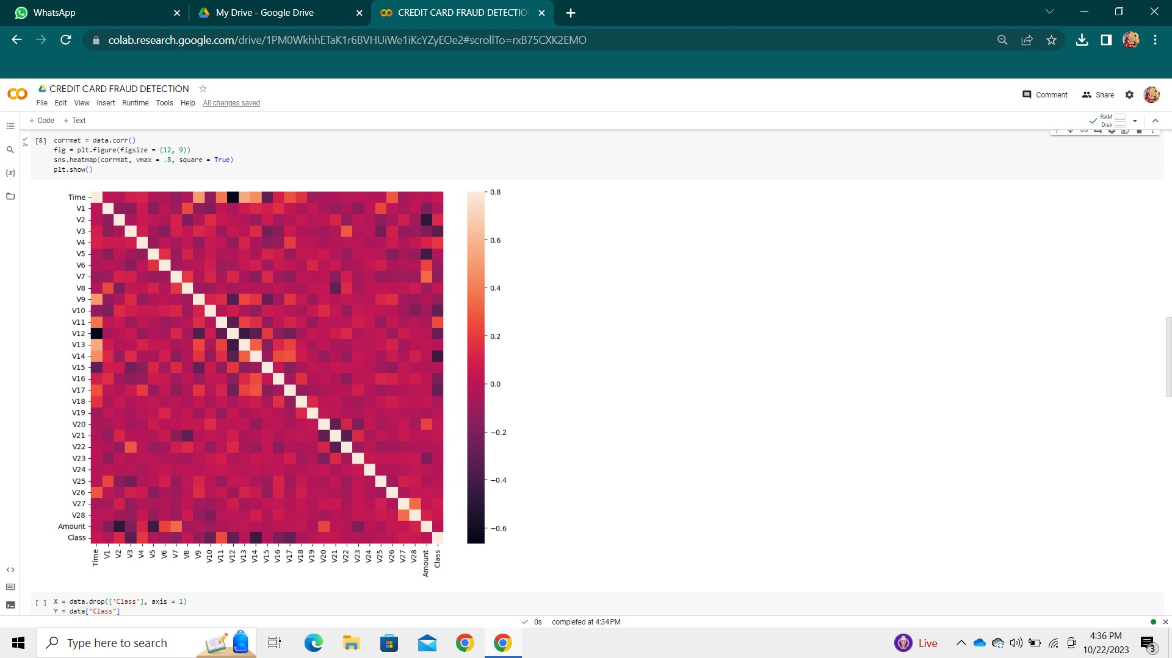

Slide 12


Slide 13


Conclusion
In this paper we developed a novel method for fraud detection, where customers are grouped based on their transactions and extract behavioral patterns to develop a profile for every cardholder. Then different classifiers are applied on three different groups later rating scores are generated for every type of classifier. This dynamic changes in parameters lead the system to adapt to new cardholder's transaction behavior timely.

Slide 14
Future Scope
Credit card fraud detection is a rapidly evolving field, and there are several areas where future research can be focused. One such area is the use of future information in fraud detection systems. A recent study proposes a new paradigm for posterior fraud detection that uses future transactions as extra context to improve detection. The study shows that this approach can catch more frauds and compromised cards than the state-of-the-art classifier that only uses past context.

Slide 15
References
[1] A. Thennakoon, C. Bhagyani, S. Premadasa, S. Mihiranga and N. Kuruwitaarachchi, ”Real-time Credit Card Fraud Detection Using Machine Learning,” 2019 9th International Conference on Cloud Computing, Data Science Engineering (Confluence), Noida, India, 2019, pp. 488-493, doi: 10.1109/CONFLUENCE.2019.8776942
[2] Satvik Vats, Surya Kant Dubey, Naveen Kumar Pandey, A Tool for Effective Detection of Fraud in Credit Card System, published in International Journal of Communication Network Security ISSN: 2231 1882, Volume-2, Issue-1, 2013
[3] S. Xuan, G. Liu, Z. Li, L. Zheng, S. Wang, and G. N. Surname, Random forest for credit card fraud detection, IEEE 15th International Conference on Networking, Sensing, and Control (ICNSC),2018.
[4] M. Hamdi Ozcelik, Ekrem Duman, Mine Isik, Tugba Cevik, Improving a credit card fraud detection system using genetic algorithm, published by International Conference on Networkingand Information Technology, 2010.
[5] Wen-Fang YU, Na Wang, Research on Credit Card Fraud Detection Model Based on Distance Sum, published by IEEE International Joint Conference on Artificial Intelligence, 2009
[6] Andreas L. Prodromidis and Salvatore J. Stolfo; ”Agent-Based Distributed Learning Applied to Fraud Detection”; Department of Computer Science- Columbia University; 2000.
[7] Salvatore J. Stolfo, Wei Fan, Wenke Lee, and Andreas L. Prodro- midis; ”Cost-based Modeling for Fraud and Intrusion Detection: Results from the JAM Project”; 0-7695-0490-6/99, 1999 IEEE
[8] . Soltani, N., Akbari, M.K., SargolzaeiJavan, M., A new userbased model for credit card fraud detection based on the artificial immune system, Artificial Intelligence and Signal Processing (AISP), 2012 16th CSI International Symposium on., IEEE, pp. 029-033, 2012.
[9] S. Ghosh and D. L. Reilly, Credit card fraud detection with a neural- network, Proceedings of the 27th Annual Conference on System Science, Volume 3: Information Systems: DSS/Knowledge-Based Systems, pages 621-630, 1994. IEEE Computer Society Press.
[10] MasoumehZareapoor, Seeja. K.R, M.Afshar.Alam, Analysis of Credit Card Fraud Detection Techniques: based on Certain Design Criteria, International Journal of Computer Applications (0975 8887) Volume 52 No.3, 2012

